Slide 1
If , elif, and else

Slide 2
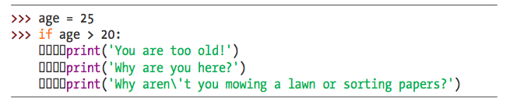
Spaces in an IF
Notice the 4 spaces (or 4 blocks [] )
What does it mean?
what happens when age = 14 ?

Slide 3
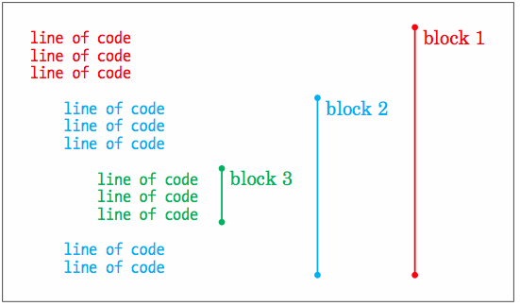
Code Blocks (Group of Code)
Notices the
spaces for each
color.
Each color
is a group of
code.

Slide 4

Coding Example
What looks odd about the statement above?
What will happen when we run it?

Slide 5
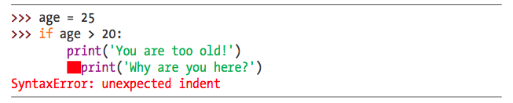
Coding Example (Continued)
ERROR! Unexpected indent.
What does it mean?

Slide 6
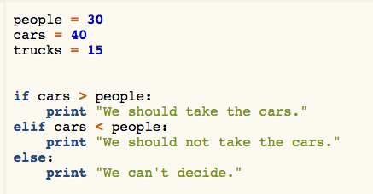
More Coding Examples
What does
this code do?
elif? what
does that do?

Slide 7

Turtle Exercise!

